Slide 1



Project-II Panel Review-2
GENERATIVE SIMULATION:
AN AGENTIC FRAMEWORK FOR WEB PLANNING
Sudarshan N Sankaran - 22BCE1045
Rishab Naveen - 22BLC1098
Tanushree Chowdhury - 22BLC1077
Guide - Dr. Karmel A (SCOPE)

Slide 3
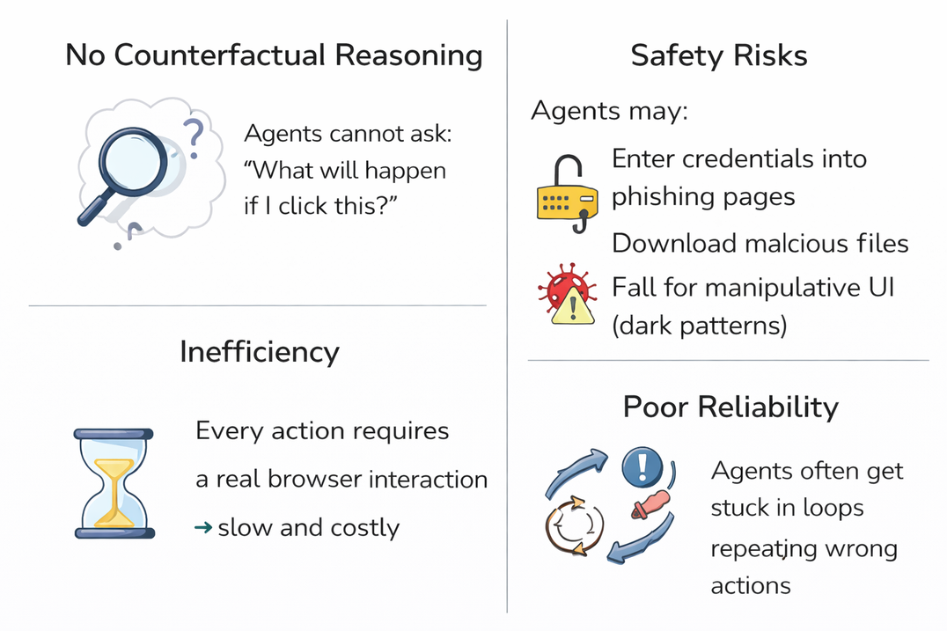
INTRODUCTION
The Problem with Current Web Agents
Current LLM-based web agents operate in a reactive loop of Reason, Act, and Observe.
They must interact with the real web to learn outcomes.
Traditional model-based agents lack the ability to reason about consequences before acting.
Because they cannot internally simulate outcomes, they rely entirely on slow and inefficient real-world feedback.
This creates severe safety risks, leaving them vulnerable to phishing pages, malicious downloads, and dark patterns.
Reactive agents have poor reliability, frequently repeating mistakes and getting stuck in loops.

Slide 4
PROJECT OBJECTIVES & PROPOSED SOLUTION
The core objective of this project is to transform traditional web automation from a purely reactive process into a deliberative, planning-based system. We propose a model-based, safety-aware, and self-correcting web agent architecture. Instead of relying on trial-and-error in a live browser, this system anticipates risks and outcomes internally, preventing harmful actions before they occur.
World Model (Counterfactual Planning): An LLM-driven engine that simulates likely future web states and structural changes before any physical click or keystroke is executed.
Sentinel Module (Risk-Aware Filtering): A proactive cybersecurity gatekeeper that analyzes those simulated futures to block unsafe paths, such as deceptive UI patterns or phishing forms.
Reflexion Module (Online Error Recovery): A learning mechanism that compares the simulated prediction against the actual web result, using any discrepancies to update the agent's memory and avoid repeating mistakes.

Slide 5
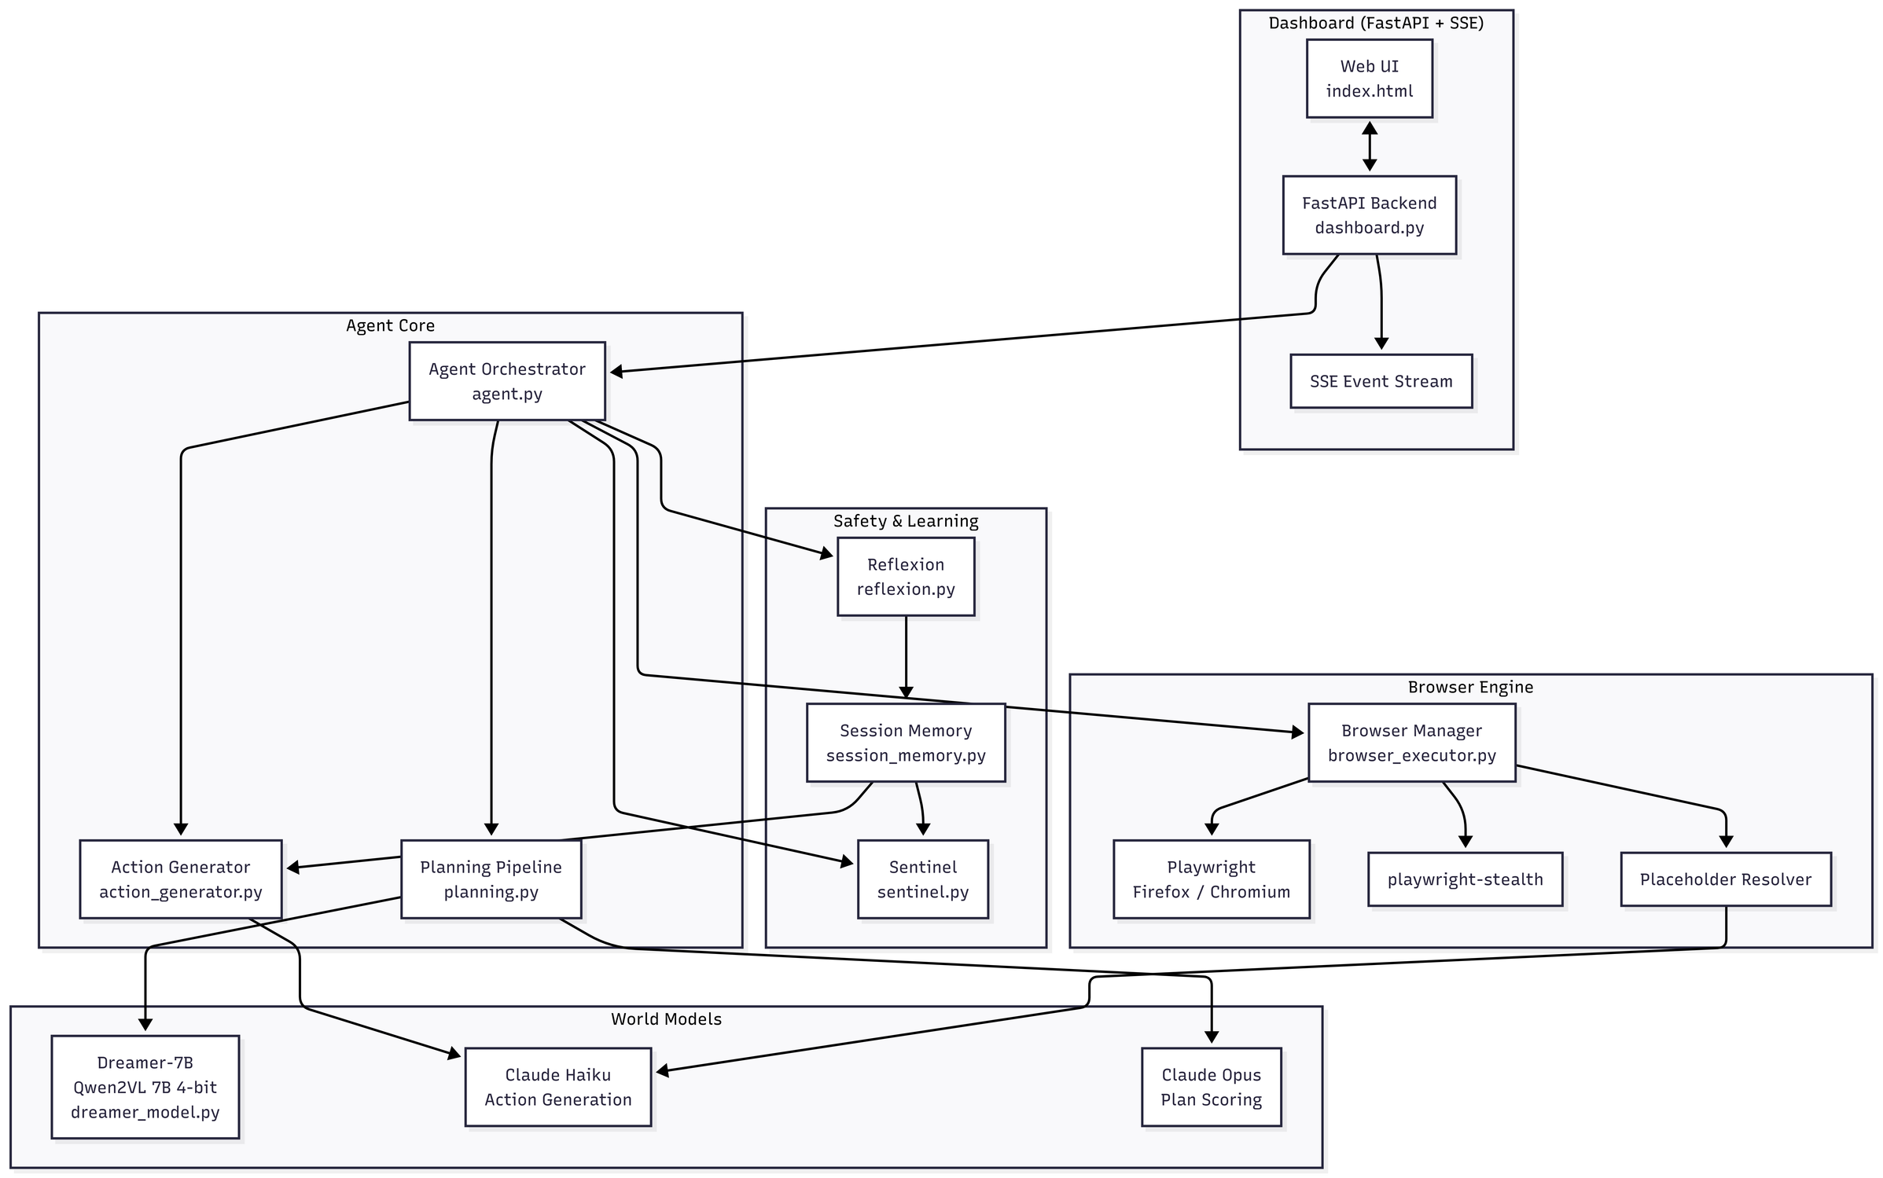
SYSTEM DESIGN & ARCHITECTURE

Slide 6
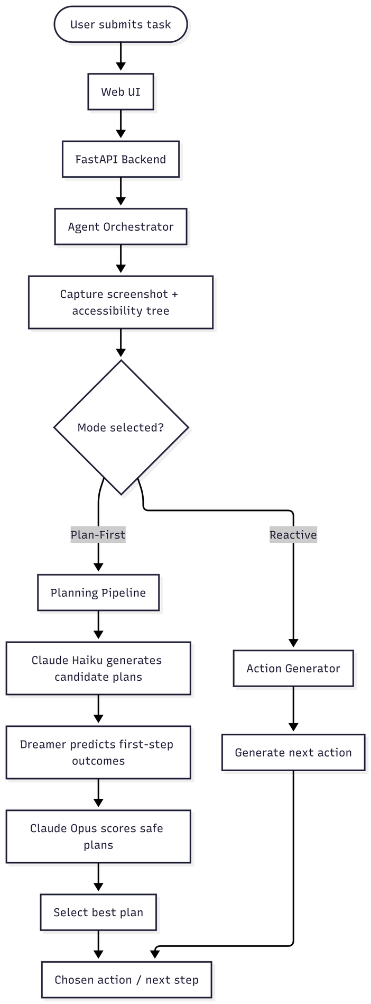
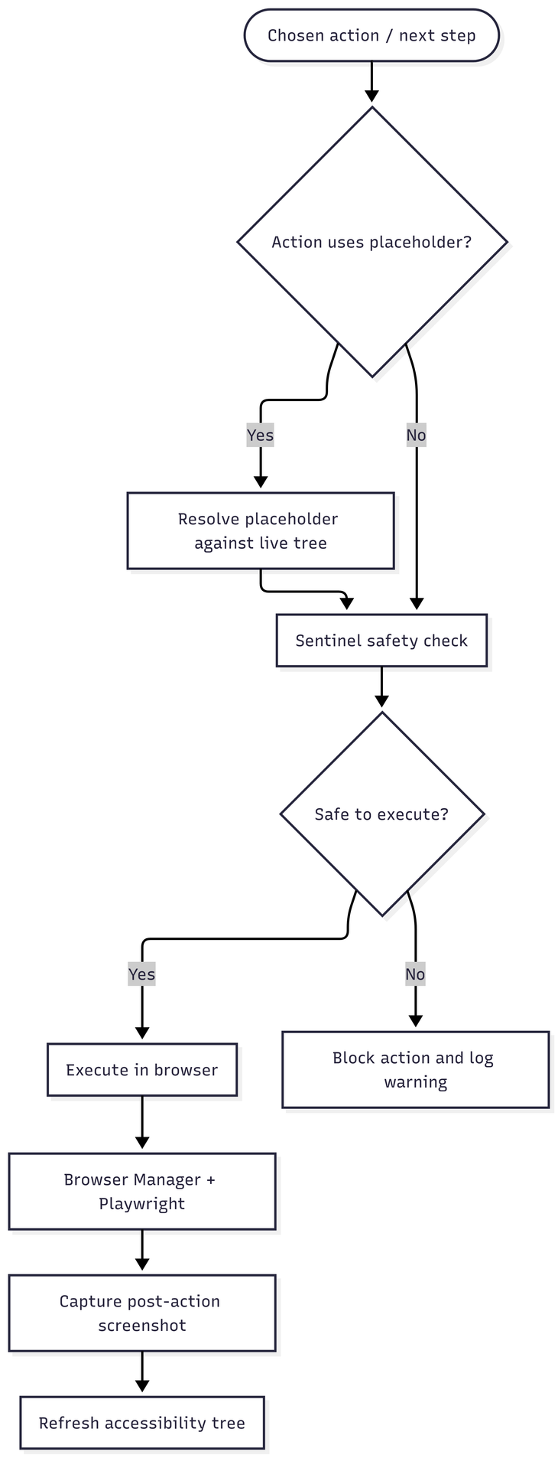
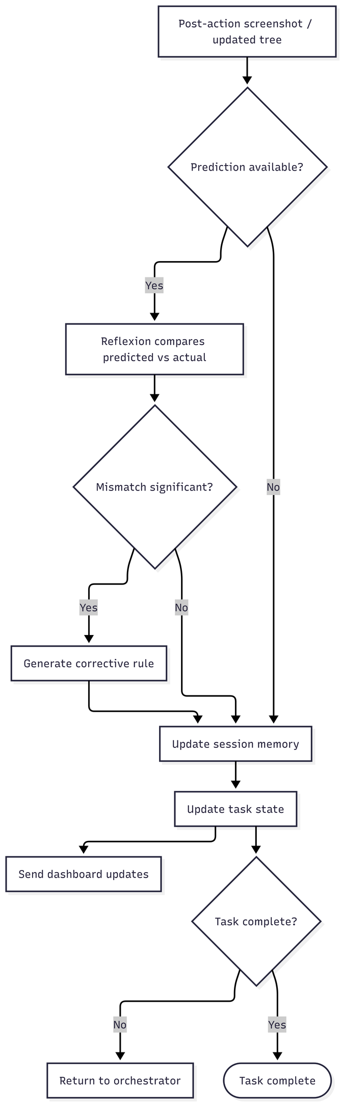
EXECUTION FLOW
A user task triggers the Agent Orchestrator to capture the initial webpage state. The system then enters either a direct "Reactive" mode or a "Plan-First" pipeline, where models generate, predict, and score candidate plans. The selected action undergoes a strict Sentinel safety check; if safe, it is executed in the browser via Playwright. Post-execution, the Reflexion module compares the predicted outcome against the actual new state, generating corrective rules for any mismatches. Finally, the system updates its memory and either loops back for the next step or marks the task as complete.

Slide 7

MODULES DEVELOPED
1. Controller Module (State Perception & Generation)
Implementation Status: Fully Functional.
Details: The controller ingests the current webpage state (via screenshots and DOM/accessibility trees) alongside the user's natural language goal. It successfully generates a diverse list of plausible next actions without committing to them.
2. World Model (Simulation Engine)
Implementation Status: Functional (using LLM APIs like GPT-4o and Dreamer-7B).
Details: Acts as the core predictive engine. Given the current page, task description, and a candidate action, the World Model generates the expected state changes. It is capable of predicting structural changes (HTML/Accessibility formats) for $k$ imagination steps into the future, preventing the agent from making irreversible, erroneous clicks on the live web.

Slide 8
MODULES DEVELOPED
3. Sentinel & Scorer Modules (Value Functions)
Implementation Status: Integrated and Testing.
Details: The Sentinel module acts as a strict guardrail, evaluating the imagined futures for malicious patterns (e.g., unexpected credential prompts) before any real action is taken. The Scorer then acts as a value function, ranking the safe simulated outcomes based on task progress likelihood and information gain.
4. Execution & Reflexion Modules
Implementation Status: Functional via Playwright.
Details: The highest-scoring action is translated into physical browser commands. If the actual outcome deviates from the World Model's prediction, the Reflexion module logs the error delta to refine subsequent simulation cycles.

Slide 9
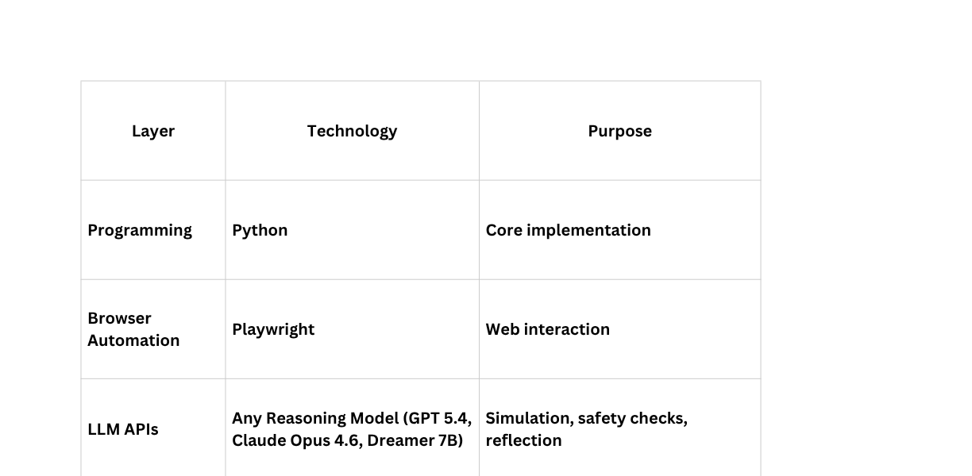
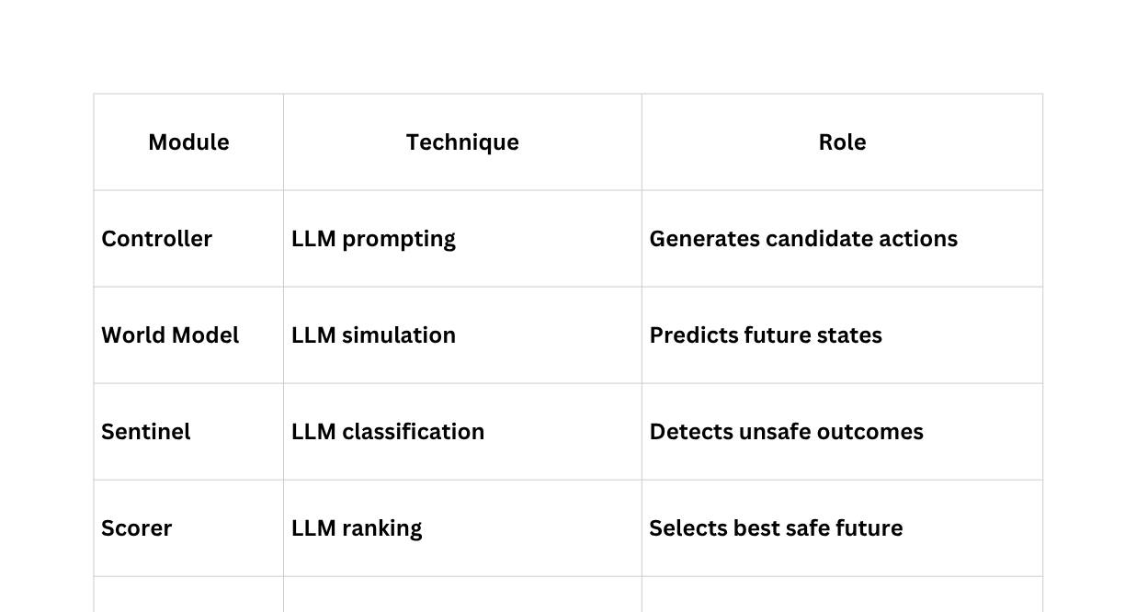
CORE TECHNOLOGIES & TOOLS

Slide 10
ALGORITHMS IMPLEMENTED
1. WORLD-MODEL-GUIDED PLAN SELECTION
GENERATE N CANDIDATE PLANS → DREAMER-7B PREDICTS STATE CHANGES FOR EACH STEP → CLAUDE SCORES PLANS USING PREDICTIONS AS CONTEXT → HIGHEST-SCORED PLAN SELECTED FOR EXECUTION. DECOUPLES PLANNING FROM EXECUTION — ALL REASONING HAPPENS BEFORE THE FIRST ACTION.
2. LLM-GROUNDED PLACEHOLDER RESOLUTION
PLANS REFERENCE UNSEEN FUTURE PAGES VIA PLACEHOLDER IDS ([?SEARCH_BOX]). AT EXECUTION TIME, THE LIVE ACCESSIBILITY TREE IS SENT TO THE LLM WHICH GROUNDS THE PLACEHOLDER TO A REAL ELEMENT ID — BRIDGING THE GAP BETWEEN ABSTRACT PLANS AND CONCRETE PAGE STATE.
3. REFLEXION-SENTINEL FEEDBACK LOOP
POST-EXECUTION, REFLEXION COMPARES DREAMER'S PREDICTED STATE AGAINST THE ACTUAL PAGE (MATCH SCORE 0.0–1.0). MISMATCHES BELOW 0.6 THRESHOLD GENERATE CORRECTIVE RULES STORED IN SESSIONMEMORY. THESE RULES ARE INJECTED INTO BOTH SENTINEL'S SAFETY EVALUATION AND FUTURE PLAN GENERATION PROMPTS — ENABLING WITHIN-SESSION SELF-CORRECTION WITHOUT RETRAINING.
4. CASCADING ELEMENT RESOLUTION
FIVE-STRATEGY LOCATOR PIPELINE: GET_BY_ROLE → GET_BY_PLACEHOLDER → GET_BY_LABEL → GET_BY_TEXT → CSS SELECTOR FALLBACK. EACH STRATEGY CHECKS VISIBILITY BEFORE ACCEPTING, PREVENTING OFF-SCREEN OR OVERLAY-BLOCKED ELEMENTS FROM BEING SELECTED.

Slide 11
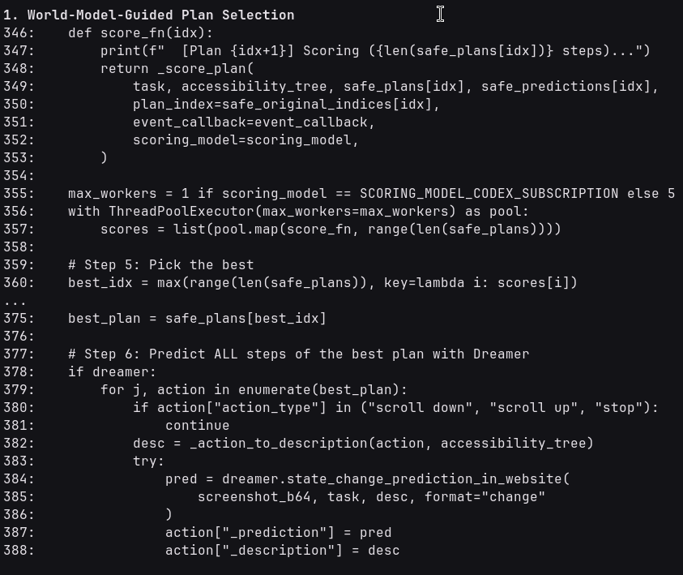
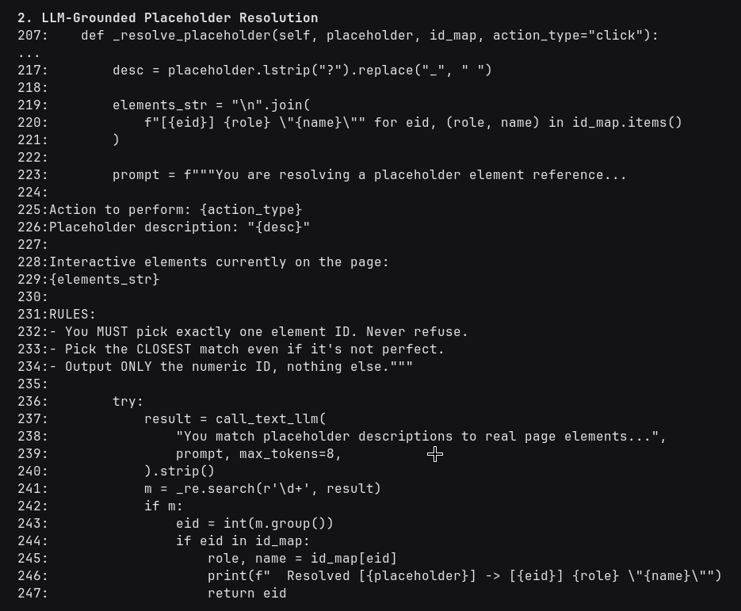
CODE SNIPPETS

Slide 12
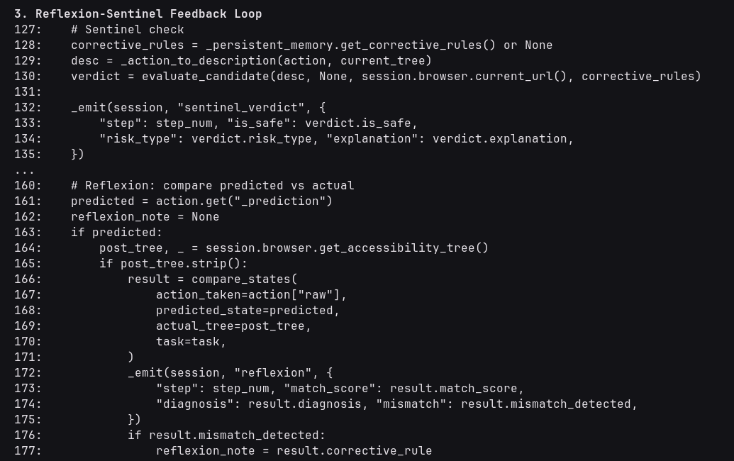
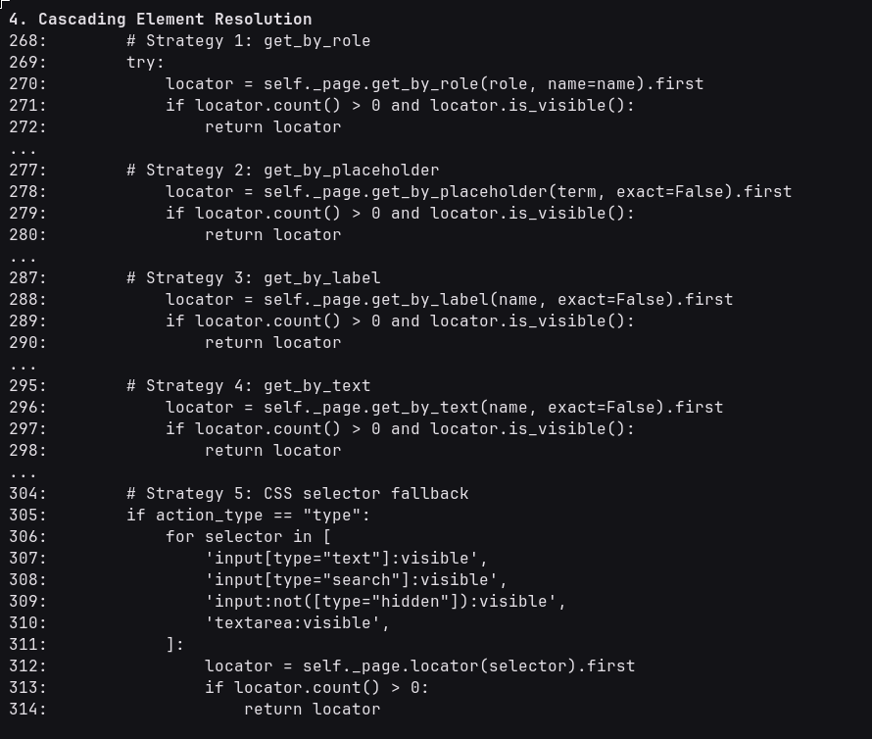
CODE SNIPPETS

Slide 13
RESULTS & ANALYSIS
We have achieved full implementation of the proposed architecture, with the core Controller module now fully functional for generating state perceptions and diverse candidate actions . The World Model and Execution modules are also actively functional, effectively predicting structural state changes into the future and executing physical browser commands via Playwright . Furthermore, the critical value function components—the Sentinel safety filter and the Scorer module—have been successfully integrated and are currently undergoing rigorous testing to ensure robust threat detection and goal alignment .
Plan-First achieves a higher success rate — pre-computing the full action sequence avoids the reactive mode's tendency to get stuck in loops (e.g. nav_2: reactive clicked the same element 8 times in a row)
Reactive-Dreamer uses 80% more steps — without a plan, Dreamer proposes exploratory actions that don't converge. On search_1, reactive took 10 steps (9 failed clicks) vs plan-first's 2 steps
Plan-First has higher latency but lower execution time — ~60-80s planning overhead, but execution is fast (pre-computed path). Reactive has no planning overhead but wastes time on failed actions (25s per timeout)

Slide 14
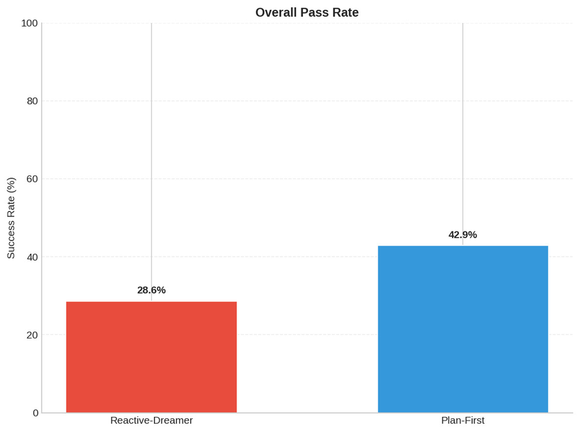
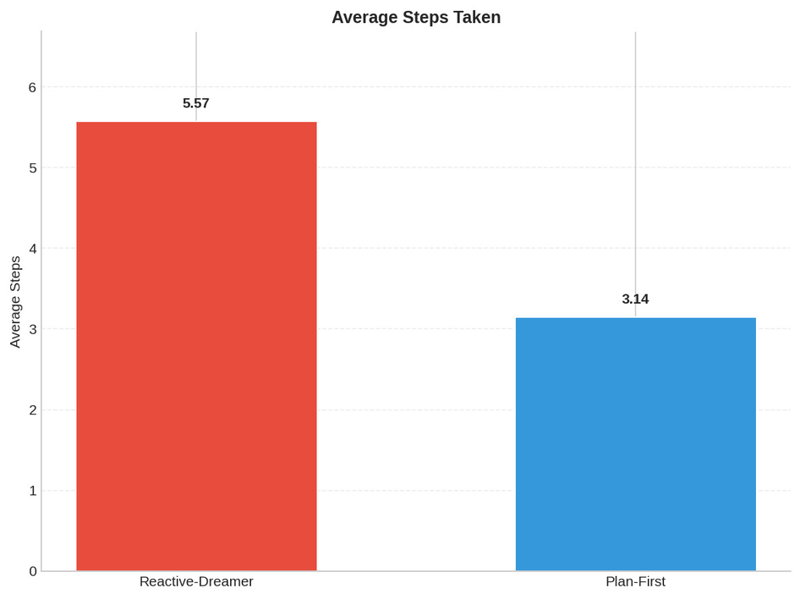
PERFORMANCE METRICS
The criteria we have evaluated our implementation on is the Overall Pass Ratio of the tasks and the total number of steps taken
As expected the plan first approach has a much higher success rate on our 7 task subset than the reactive approach.
Again as expected the plan first approach has less steps as the reactive approach

Slide 15
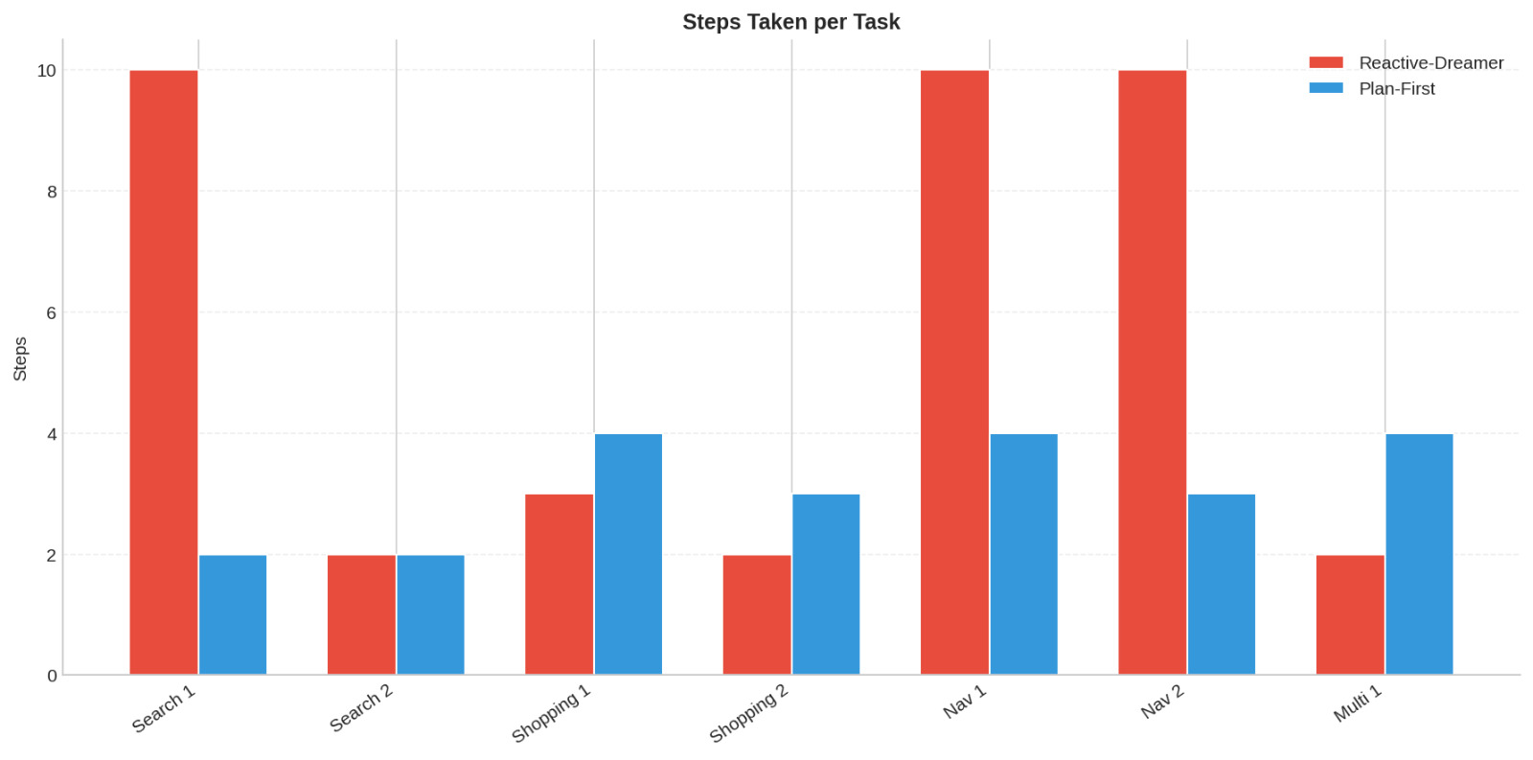
PERFORMANCE METRICS
This bar chart highlights how the Plan-First model prevents the severe inefficiencies seen in the Reactive-Dreamer architecture during complex tasks. While the reactive model gets stuck in loops and hits a 10-step cap on tasks like "Search 1" and "Nav 1," the planning model efficiently completes them in just 2 to 4 steps. Even though it occasionally takes an extra step on a few simpler tasks, the Plan-First approach delivers vastly superior reliability overall.

Slide 16
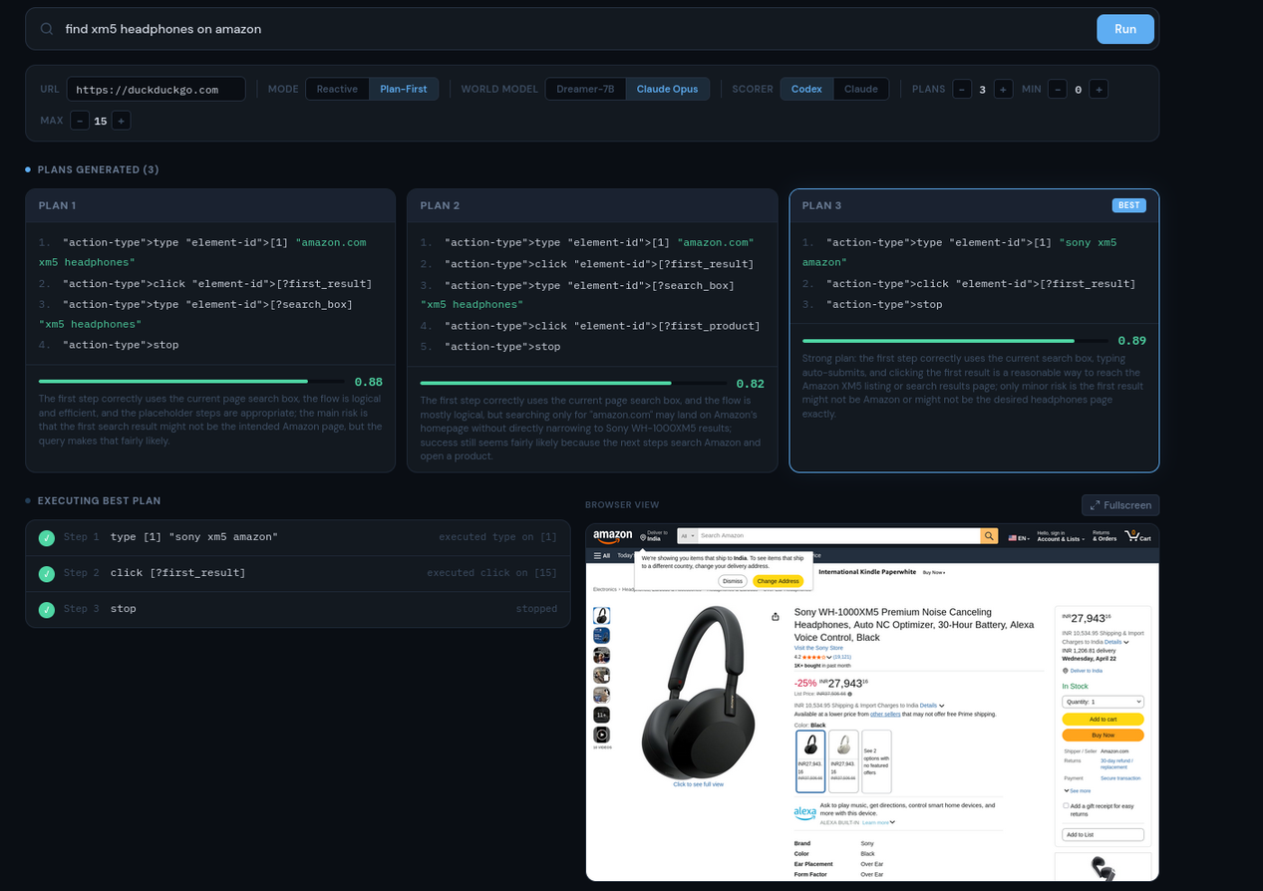
TESTING OUTCOMES
To validate the implementation, the system was tested on real-world e-commerce and information-seeking tasks.
The outputs confirm the agent successfully evaluates multiple candidate actions (e.g., "click search" vs. "navigate to category"), simulates the respective HTML/accessibility changes, passes them through the Sentinel, and confidently executes the optimal path.
The integration effectively avoids the common "infinite loop" traps seen in purely reactive agents by looking ahead.

Slide 17
CHALLENGES & SOLUTIONS
Current web agents blindly interact with the internet, making them highly vulnerable to malicious environments. They cannot anticipate risks and often unknowingly perform harmful actions, such as entering credentials into phishing pages, downloading malicious files, or falling for manipulative UI designs known as "dark patterns". Furthermore, rigid rule-based bots fail entirely when websites dynamically update their layouts or when tasks require general reasoning.
Our framework addresses these vulnerabilities through the Sentinel Safety Module, which acts as a strict, pre-action assessment gate.
Pre-Execution Filtering: The module operates entirely on simulated futures, ensuring safety before any physical interaction with the live web.
Threat Classification: Each predicted state is passed through a classifier prompt that actively scans for social engineering signals (like fake warnings or false urgency).
Pattern Recognition: It successfully identifies expected structural traps, such as credential input fields resembling phishing forms and suspicious download prompts.

Slide 18
CHALLENGES & SOLUTIONS
Traditional reactive agents lack counterfactual reasoning - they cannot internally ask, "What will happen if I click this?". Because they must rely entirely on real-world feedback, every single action requires a real browser interaction, which is inherently slow, costly, and resource-heavy. When these agents make a wrong decision, they frequently get stuck in infinite operational loops, blindly repeating the
We solve this inefficiency through Counterfactual Web State Simulation combined with active error recovery.
Preventing Irreversible Mistakes: By simulating structural and functional changes up to “k” imagination steps into the future, the agent avoids making erroneous clicks on the live web.
Triggering Reflexion: After executing an action, if the actual webpage result deviates significantly from the World Model's prediction, the Reflexion module activates.
Diagnostic Memory Updates: The LLM diagnoses why the simulation failed, identifies misleading UI transitions, and logs the error delta to update the session memory with a corrective rule.

Slide 19
REMAINING WORK
Phase 4 (Full Implementation): Deployment and Persistent Memory along with comparison of model performance and evaluation across these models, namely WebDreamer-7B, Claude Opus 4.6, GPT 5.4, this phase will conclude by the end of March 2026.
Phase 5 (Research Paper & Project Report): Dedicate roughly 15 days to formalize our findings, methodology, and performance metrics into the final Research Paper by Early April 2026.
Phase 6 (Final Review): Prepare the demonstration and final deliverables for the Project Review scheduled for April 15th, 2026.

Slide 20
REFERENCES
Zhou, S. et al. (2025). WebArena Verified.
Wang, L. et al. (2025). AgentVigil.
Liu, Y. et al. (2025). LLM-based Agents Suffer from Hallucinations.
Kumar, A. et al. (2024). SCoRe.
Zhang, J. et al. (2024). R-Judge.
Gou, Z. et al. (2024). CRITIC.
Zheng, B. et al. (2024). SeeAct.
Deng, X. et al. (2023). Mind2Web.
Nandu, A. et al. (2025). Smart Detection of Malicious URLs Using a Hybrid Machine Learning Approach.
Shinn, N. et al. (2023). Reflexion.
Yao, S. et al. (2023). ReAct.
Alnemari, S. et al. (2024). Phishing Website Detection Using Improved Multilayered Convolutional Neural Networks.
Yang, H. et al. (2023). Auto-GPT Analysis.
IJIRMPS (2025). Real-Time Detection of Malicious URLs Using Feature-Based ML.
EDPB (2025). Al Privacy Risks.

